Slide 1
Database Automation

Slide 2

Agenda
History of Database
Database - Overview
Difference between DBMS and RDBMS
RDBMS Architecture
Structured Query Language
Commands
Aggregate & Scalar functions
Joins
Database normalization
1NF
2NF
3NF
BCNF
De-Normalization
Database Test automation flow
How to Interact with DB using Automation
Database connection using ADODB
Database connection using C#
No SQL
NoSQL vs RDBMS

Slide 3
History of SQL Database
Dr. Edgar F. Codd was English Computer Scientist who introduced the Relational Model, while he was working with IBM, UK. In the year 1970, he published the paper "A Relational Model of Data for Large Shared Data Banks" in the Association of Computer Machinery (ACM) Journal, communications of the ACM.
At present the Codd’s model is now accepted as the definitive model for Relational Database Management Systems (RDBMS). The language, Structured English Query Language (SEQUEL) was developed by IBM Corporation, Inc., to use Codd's model. In 1979, Relational Software, Inc. (now Oracle) introduced the first commercially available implementation of SQL. Today, SQL is accepted as the standard RDBMS language.
Developed by: Donald D. Chamberlin and Raymond F. Boyce in the early 1970’s at IBM to Manipulate and Retrieve data stored in IBM’s Quasi-relational database Management called SYSTEM R.
Pronunciation:
SEQUEL later became SQL (still pronounced "sequel"). Because SEQUEL was a Trade Mark of the UK-Based Hawker aircraft company.
Standards:
SQL became a standard of the American National Standard Institute (ANSI) in 1986 and later in 1987 it was also part of ISO.
Notes:
The DBMS manages three important things: the data, the database engine that allows data to be accessed, locked and modified -- and the database schema, which defines the database’s logical structure. These three foundational elements help provide concurrency, security, data integrity and uniform administration procedures.

Slide 4
Database - Overview
A database is an organized collection of data. It is the collection of schemas, tables, queries, reports, views and other objects. The data are typically organized to model aspects of reality in a way that supports processes requiring information, such as finding a hotel with vacancies.
What is DBMS and RDBMS
A database management system (DBMS) is system software for creating and managing databases. The DBMS provides users and programmers with a systematic way to create, retrieve, update and manage data.
RDBMS stands for Relational Database Management System that stores data in the form of relational tables. Relational databases are powerful because they require few assumptions about how data is related or how it will be extracted from the database. Edgar Codd introduced the relational database model.
The most popular RDBMS are MS SQL Server, DB2, Oracle and MySQL.
Notes:
The DBMS manages three important things: the data, the database engine that allows data to be accessed, locked and modified -- and the database schema, which defines the database’s logical structure. These three foundational elements help provide concurrency, security, data integrity and uniform administration procedures.

Slide 5
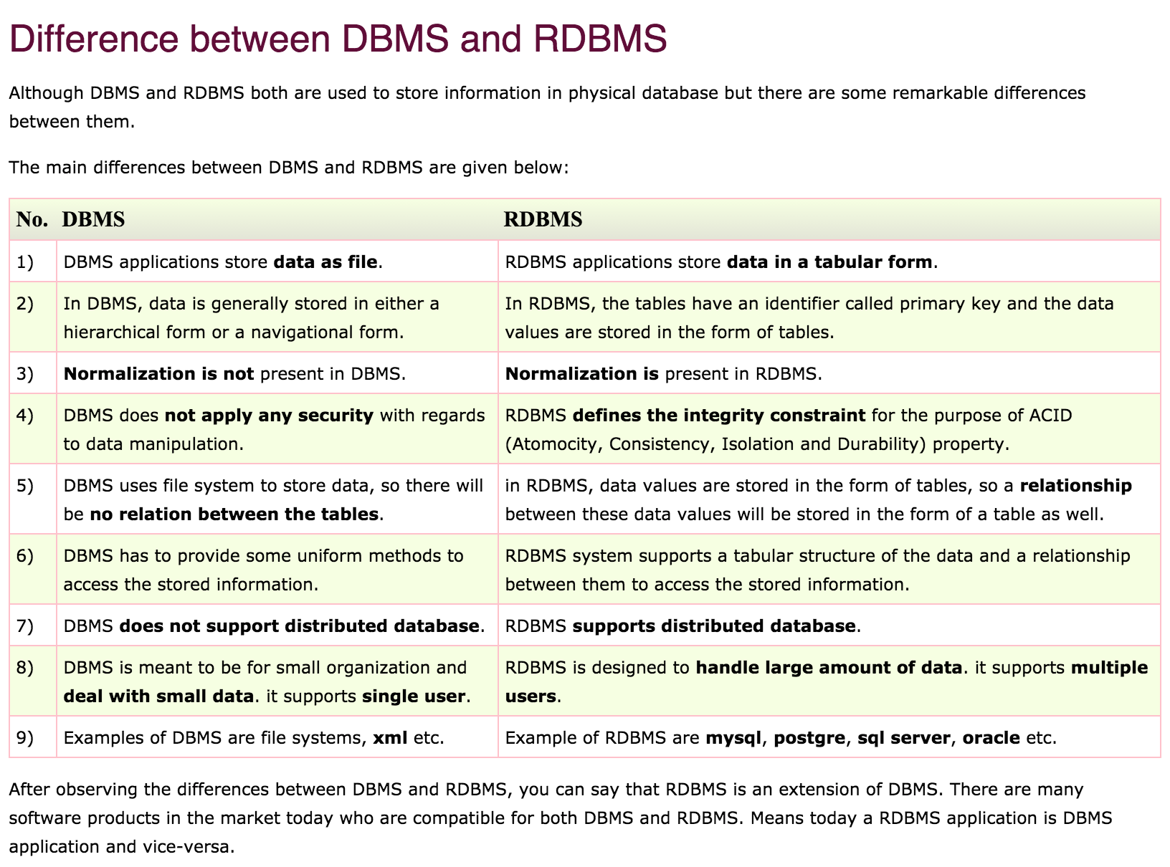
Difference between DBMS and RDBMS

Slide 6
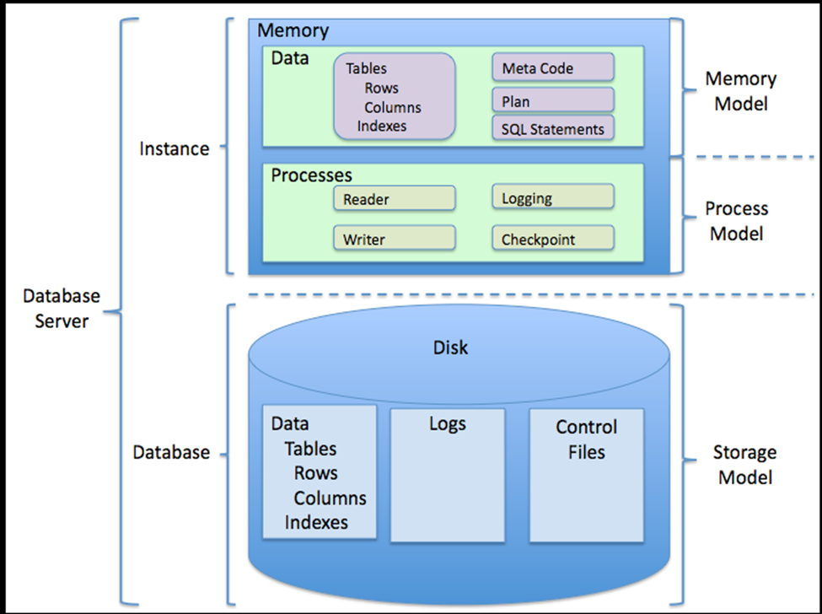
RDBMS ARCHITECTURE

Slide 7
SQL Commands
SQL commands can be divided in to five subgroups as below
DDL (Data Definition Language): refers to the CREATE, ALTER and DROP statements
DDL allows to add / modify / delete the logical structures which contain the data or which allow users to access / maintain the data (databases, tables, keys, views...). DDL is about "metadata".
DML (Data Manipulation Language): refers to the INSERT, UPDATE and DELETE statements
DML allows to add / modify / delete data itself.
DQL (Data Query Language): refers to the SELECT, SHOW and HELP statements (queries)
SELECT is the main DQL instruction. It retrieves data you need. SHOW retrieves info about the metadata. HELP... is for people who need help.
DCL (Data Control Language): refers to the GRANT and REVOKE statements
DCL is used to grant / revoke permissions on databases and their contents. DCL is simple, but MySQL's permissions are rather complex. DCL is about security.
DTL (Data Transaction Language): refers to the START TRANSACTION, SAVEPOINT, COMMIT and ROLLBACK [TO SAVEPOINT] statements
DTL is used to manage transactions (operations which include more instructions none of which can be executed if one of them fails).

Slide 8
SQL Commands
SQL has Statements, Clauses, Operators using Wild Card Characters, Constraints.
STATEMENTS
CREATE DATABASE, CREATE TABLE, INSERT INTO, UPDATE, DELETE, SELECT, DISTINCT, SELECT INTO, INSERT INTO, CREATE INDEX, DROP INDEX, DROP TABLE, DROP DATABASE, ALTER
CLAUSES
WHERE, SELECT TOP, UNIONS, ORDERBY, GROUPBY, HAVING
OPERATORS
AND & OR, BETWEEN, IN, LIKE, NOT, UNIQUE, IS NULL
OPERATERS using WILDCARD
%, _
CONSTRAINTS
NOT NULL, DEFAULT, UNIQUE, PRIMARY KEY, FOREIGN KEY, CHECK, INDEX

Slide 9
Aggregate & Scalar Functions
AGGREGATE FUNCTIONS | DESCRIPTION
AVG | Returns the average value of a given column
MIN | Returns the Smallest Value in a given column
MAX | Returns the Largest Value in a given column
SUM | Returns the sum of the numeric value in a given column
Count | Returns the Total Number of values in a given column
Count(*) | Returns the number of rows in a table
SCALAR FUNCTIONS
UCASE | Converts a field to Upper Case
LCASE | Converts a field to Lower Case
MID | Extract Characters from a text field
ROUND | Rounds a Numeric field to the number of decimals specified
NOW | Returns the Current System date and time
FORMAT | Formats how a field is to be displayed

Slide 10
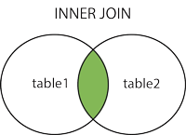
JOINS
JOINS : An SQL JOIN clause is used to combine rows from two or more tables, based on a common field between them.
There are different joins available in SQL as listed below.
INNER JOIN: Returns all rows when there is at least one match in BOTH tables
LEFT OUTER JOIN: Return all rows from the left table, and the matched rows from the right table
RIGHT OUTER JOIN: Return all rows from the right table, and the matched rows from the left table
FULL OUTER JOIN: Return all rows when there is a match in ONE of the tables
INNER JOIN: The INNER JOIN keyword selects all rows from both tables as long as there is a match between the columns in both tables.
Syntax:
SELECT column_name(s) FROM table1 INNER JOIN table2 ON table1.column_name=table2.column_name;

Slide 11
INNER JOIN
As an example, let's say that an Insurance company wants to know policy holders have added Driver to their policies, they might create two tables.
Policy table
Driver table
id | eff_date | exp_date | state | premium
1001 | 5/5/2016 | 11/5/2016 | AL | 4000
1003 | 4/27/2016 | 10/28/2016 | CA | 3456
1006 | 4/10/2016 | 10/11/2016 | AL | 7634
1004 | 5/15/2016 | 11/16/2016 | GA | 8764
1010 | 6/17/2016 | 12/18/2016 | GA | 3000
1090 | 10/13/2012 | 9/13/2018 | SD | 5100
id | policy_id | first_name | last_name | dob | ssn
101 | 1001 | Sam | Wahl | 10/10/1980 | 8977789789
102 | 1005 | Nicole | John | 9/14/1973 | 8977789790
103 | 1010 | Sam | Jacob | 11/20/1985 | 8977789791
104 | 1090 | Allen | Sam | 25/11/1982 | 8977789792
105 | 1100 | Susen | Miller | 10/12/1987 | 8977789793
106 | 1003 | Jennifer | Lopez | 3/5/1970 | 8977789794
Example for Inner Join Query:
SELECT policy.id,driver.first_name,driver.last_name,policy.premium,driver.ssn from Policy INNER JOIN Driver ON policy.id = driver.policy_id;
Result of the query
id | first_name | last_name | premium | ssn
1001 | Sam | Wahl | 4000 | 8977789789
1010 | Nicole | John | 3000 | 8977789791
1003 | Jennifer | Lopez | 3456 | 8977789794
1090 | Allen | Sam | 5100 | 8977789792

Slide 12
INNER JOIN (contd)
One more example :
Driver table
Vehicle table
id | policy_id | first_name | last_name | dob | ssn
101 | 1001 | Sam | Wahl | 10/10/1980 | 8977789789
102 | 1005 | Nicole | John | 9/14/1973 | 8977789790
103 | 1010 | Sam | Jacob | 11/20/1985 | 8977789791
104 | 1090 | Allen | Sam | 25/11/1982 | 8977789792
105 | 1100 | Susen | Miller | 10/12/1987 | 8977789793
106 | 1003 | Jennifer | Lopez | 3/5/1970 | 8977789794
id | driver_id | model | make | coverage
345 | 101 | Toyota | 2010 | 20000
234 | 106 | Ford | 2011 | 22000
123 | 101 | Nissan | 2010 | 25000
265 | 102 | Bmw | 2015 | 60000
341 | 110 | Honda | 2016 | 80000
675 | 105 | Audi | 2016 | 150000
Example for Inner Join Query:
SELECT vehicle.id as “vehicleid”,driver.id as “driverid” ,driver.state, vehicle.model,vehicle.coverage from Driver INNER JOIN Vehicle ON driver.id = vehicle.driver_id;
Result of the query
vehicleid | driverid | state | model | coverage
345 | 101 | CA | Toyota | 20000
123 | 101 | CA | Nissan | 25000
341 | 110 | CA | Honda | 80000

Slide 13
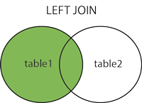
LEFT OUTER JOIN
SQL LEFT OUTER JOIN Keyword:
The LEFT JOIN keyword returns all rows from the left table (table1), with the matching rows in the right table (table2). The result is NULL in the right side when there is no match. In some databases this is called as Left Outer Join.
Syntax:
SELECT column_name(s) FROM table1 LEFT OUTER JOIN table2 ON table1.column_name=table2.column_name;
Example for Left Outer Join Query:
SELECT policy.id,driver.first_name,driver.last_name,policy.premium,driver.ssn from Policy LEFT OUTER JOIN Driver ON policy.id = driver.policy_id;
Result of the query
id | first_name | last_name | premium | ssn
1001 | Sam | Wahl | 4000 | 8977789789
1003 | Jennifer | Lopez | 3456 | 8977789794
1006 | null | null | 7634 | null
1004 | null | null | 8764 | null
1010 | Sam | Jacob | 3000 | 8977789791
1090 | Allen | Sam | 5100 | 8977789792

Slide 14
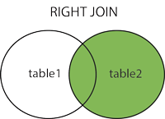
RIGHT OUTER JOIN
SQL RIGHT OUTER JOIN Keyword:
The RIGHT JOIN keyword returns all rows from the right table (table2), with the matching rows in the left table (table1). The result is NULL in the left side when there is no match. In some databases this is called as Right Outer Join.
Syntax:
SELECT column_name(s) FROM table1 RIGHT OUTER JOIN table2 ON table1.column_name=table2.column_name;
Example for Right Outer Join Query:
SELECT policy.id,driver.first_name,driver.last_name,policy.premium,driver.dob from Policy RIGHT OUTER JOIN Driver ON policy.id = driver.policy_id
Result of the query
id | first_name | last_name | premium | dob
1001 | Sam | Wahl | 4000 | 10/10/1980
null | Nicole | John | null | 9/14/1973
1010 | Sam | Jacob | 3000 | 11/20/1985
1090 | Allen | Sam | 5100 | 25/11/1982
null | Susen | Miller | null | 10/12/1987
1003 | Jennifer | Lopez | 3456 | 3/5/1970

Slide 15
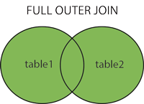
FULL OUTER JOIN
SQL FULL OUTER JOIN Keyword:
The FULL OUTER JOIN keyword returns all rows from the left table (table1) and from the right table (table2). The FULL OUTER JOIN keyword combines the result of both LEFT and RIGHT joins.
Syntax:
SELECT column_name(s) FROM table1 FULL OUTER JOIN table2 ON table1.column_name=table2.column_name;
Example for Full Outer Join Query :
SELECT policy.id,driver.first_name,policy.premium,driver.dob from Policy FULL OUTER JOIN Driver ON policy.id = driver.policy_id ;
Result of the query
id | first_name | premium | dob
1001 | Sam | 4000 | 10/10/1980
1003 | Jennifer | 3456 | 3/5/1970
1006 | null | 7634 | null
1004 | null | 8764 | null
1010 | Sam | 3000 | 11/20/1985
1090 | Allen | 5100 | 25/11/1982
null | Nicole | null | 9/14/1973
null | Susen | null | 10/12/1987

Slide 16
FULL OUTER JOIN (contd)
Driver table
Vehicle table
id | policy_id | first_name | last_name | dob | ssn
101 | 1001 | Sam | Wahl | 10/10/1980 | 8977789789
102 | 1005 | Nicole | John | 9/14/1973 | 8977789790
103 | 1010 | Sam | Jacob | 11/20/1985 | 8977789791
104 | 1090 | Allen | Sam | 25/11/1982 | 8977789792
105 | 1100 | Susen | Miller | 10/12/1987 | 8977789793
106 | 1003 | Jennifer | Lopez | 3/5/1970 | 8977789794
id | driver_id | model | make | coverage
345 | 101 | Toyota | 2010 | 20000
234 | 106 | Ford | 2011 | 22000
123 | 101 | Nissan | 2010 | 25000
265 | 102 | Bmw | 2015 | 60000
341 | 110 | Honda | 2016 | 80000
675 | 105 | Audi | 2016 | 150000
Example for Full Outer Join query:
SELECT driver.id,driver.first_name,vehicle.model,vehicle.coverage from Driver FULL OUTER JOIN vehicle ON driver.id = vehicle.driver_id
id | first_name | model | coverage
101 | Sam | Toyota | 20000
101 | Sam | Nissan | 25000
102 | Nicole | null | null
103 | Sam | null | null
104 | Allen | null | null
105 | Susen | Audi | 150000
106 | Jennifer | null | null
null | null | Ford | 22000
null | null | Bmw | 60000
null | null | honda | 80000
Result of the
query

Slide 17
JOINS (contd)
SELF JOIN:
A self-join is a query in which a table is joined (compared) to itself. Self-joins are used to compare values in a column with other values in the same column in the same table.
Example:
We have the following data into the table DRIVER.
Policy_id | Name | Agent
1002 | Sam | Andrew
1004 | Nicole | Jacob
1003 | Jenifer | John
1002 | Allen | Andrew
1010 | Susan | Andrew
1045 | John | Sam
1090 | Andrew | Sam
Policy ID | Policyholder Name | Agent Name | Agent Policy ID
1002 | Sam | Andrew | 1090
1010 | Susan | Andrew | 1090
1020 | Allen | Andrew | 1090
1045 | John | Sam | 1002
1090 | Andrew | Sam | 1002
To get the list of policy holders with the same agents and in the order of the policy number of policy holders, the following sql statement can be used :
SELECT a.policy_id as ‘”Policy ID”, a.name as “Policyholder Name”,b.agent as “Agent Name”, b.policy_id as “Agent Policy ID” from policy a, policy b where a.Name = b.Agent;
Notes:
The above data shows :
Andrew is the agent for Sam, Allen and Susan. Sam is the agent for john and Andrew.

Slide 18
SQL subquery and Correlated Subquery
Subquery or Inner query or Nested query is a query in a query. SQL subquery is usually added in the WHERE Clause of the SQL statement. Most of the time, a subquery is used when you know how to search for a value using a SELECT statement, but do not know the exact value in the database.
Subqueries are an alternate way of returning data from multiple tables.
Subqueries can be used with SELECT, INSERT, UPDATE, DELETE statements along with the comparision operators like =, <, >, >=, <= , IN, LIKE, NOT IN, NO TLIKE etc.
Correlated Subquery
A query is called correlated subquery when both the inner query and the outer query are interdependent. For every row processed by the inner query, the outer query is processed as well. The inner query depends on the outer query before it can be processed.
Subquery Notes
Nested Subquery
1) You can nest as many queries you want but it is recommended not to nest more than 16 subqueries in oracle
Non-Correlated Subquery
2) If a subquery is not dependent on the outer query it is called a non-correlated subquery

Slide 19
Subquery (contd)
Driver table
Vehicle table
id | policy_id | first_name | last_name | dob | ssn
101 | 1001 | Sam | Wahl | 10/10/1980 | 8977789789
102 | 1005 | Nicole | John | 9/14/1973 | 8977789790
103 | 1010 | Sam | Jacob | 11/20/1985 | 8977789791
104 | 1090 | Allen | Sam | 25/11/1982 | 8977789792
105 | 1100 | Susen | Miller | 10/12/1987 | 8977789793
106 | 1003 | Jennifer | Lopez | 3/5/1970 | 8977789794
id | driver_id | model | make | coverage
345 | 101 | Toyota | 2010 | 20000
234 | 106 | Ford | 2011 | 22000
123 | 101 | Nissan | 2010 | 25000
265 | 102 | BMW | 2015 | 60000
341 | 110 | Honda | 2016 | 80000
675 | 105 | Audi | 2016 | 150000
Example for Subquery :
SELECT driver.id, driver.first_name, vehicle.model,vehicle.coverage from Driver where driver.id IN ( select driver.id from Driver INNER JOIN Vehicle ON driver.id = vehicle.id)
id | first_name | model | coverage
101 | Sam | toyota | 20000
101 | Sam | Nissan | 25000
102 | Nicole | BMW | 60000
105 | Susen | Audi | 150000
106 | Jennifer | Ford | 22000
Result of the
query

Slide 20
What is Normalization
Normalization of Database
Database Normalization is a technique of organizing the data in the database. Normalization is a systematic approach of decomposing tables to eliminate data redundancy and undesirable characteristics like Insertion, Update and Deletion Anomalies. It is a multi-step process that puts data into tabular form by removing duplicated data from the relation tables.
Normalization is used for mainly two purpose, Eliminating redundant(useless) data.
Ensuring data dependencies make sense i.e. data is logically stored.
Normalization rule are divided into following normal form.
First Normal Form
Second Normal Form
Third Normal Form
BCNF
Notes:
Problem Without Normalization
Without Normalization, it becomes difficult to handle and update the database, without facing data loss. Insertion, Update and Deletion Anomalies are very frequent if Database is not Normalized. To understand these anomalies let us take an example of Student table.
S_id
S_Name
S_Address
Subject_opted
401
Adam
Noida
Bio
402
Alex
Panipat
Maths
403
Stuart
Jammu
Maths
404
Adam
Noida
Physics
Update Anomaly : To update address of a student who occurs twice or more than twice in a table, we will have to update S_Address column in all the rows, else data will become inconsistent.
Insertion Anomaly : Suppose for a new admission, we have a Student id(S_id), name and address of a student but if student has not opted for any subjects yet then we have to insert NULL there, leading to Insertion Anomaly.
Deletion Anomaly : If (S_id) 401 has only one subject and temporarily he drops it, when we delete that row, entire student record will be deleted along with it.

Slide 21
Normalization
First Normal Form (1NF):
As per First Normal Form, no two Rows of data must contain repeating group of information i.e each set of column must have a unique value, such that multiple columns cannot be used to fetch the same row. Each table should be organized into rows, and each row should have a primary key that distinguishes it as unique.
The Primary key is usually a single column, but sometimes more than one column can be combined to create a single primary key. For example consider a table which is not in First normal form
Students Table:
Student | Age | Subject
Adam | 15 | Biology, Maths
Alex | 14 | Maths
Stuart | 17 | Maths
In First Normal Form, any row must not have a column in which more than one value is saved, like separated with commas. Rather than that, we must separate such data into multiple rows.
Student | Age | Subject
Adam | 15 | Biology
Adam | 15 | Maths
Alex | 14 | Maths
Stuart | 17 | Maths

Slide 22
Normalization (Contd)
Second Normal Form (2NF):
As per the Second Normal Form there must not be any partial dependency of any column on primary key. It means that for a table that has concatenated primary key, each column in the table that is not part of the primary key must depend upon the entire concatenated key for its existence. If any column depends only on one part of the concatenated key, then the table fails Second normal form.
In example of First Normal Form there are two rows for Adam, to include multiple subjects that he has opted for. While this is searchable, and follows First normal form, it is an inefficient use of space. Also in the above Table in First Normal Form, while the candidate key is {Student, Subject}, Age of Student only depends on Student column, which is incorrect as per Second Normal Form. To achieve second normal form, it would be helpful to split out the subjects into an independent table, and match them up using the student names as foreign keys.
In Student Table the candidate key will be Student column, because all other column i.e. Age is dependent on it.
New Subject Table introduced for 2NF :
Student | Age
Adam | 15
Alex | 14
Stuart | 17
Student | Subject
Adam | Biology
Adam | Maths
Alex | Maths
Stuart | Maths
In Subject Table the candidate key will be {Student, Subject} column. Now, both the above tables qualifies for Second Normal Form and will never suffer from Update Anomalies. Although there are a few complex cases in which table in Second Normal Form suffers Update Anomalies, and to handle those scenarios Third Normal Form is there.

Slide 23
Normalization (Contd)
Third Normal Form (3NF):
Third Normal form applies that every non-prime attribute of table must be dependent on primary key, or we can say that, there should not be the case that a non-prime attribute is determined by another non-prime attribute. So this transitive functional dependency should be removed from the table and also the table must be in Second Normal form. For example, consider a table with following fields.
Student_Detail Table :
Student_id | Student_name | DOB | Street | city | State | Zip
In this table Student_id is Primary key, but street, city and state depends upon Zip. The dependency between zip and other fields is called transitive dependency. Hence to apply 3NF, we need to move the street, city and state to new table, with Zip as primary key.
New Student_Detail Table :
Student_id | Student_name | DOB | Zip
Address Table :
Zip | Street | city | state
The advantage of removing transitive dependency is,
Amount of data duplication is reduced.
Data integrity achieved.

Slide 24
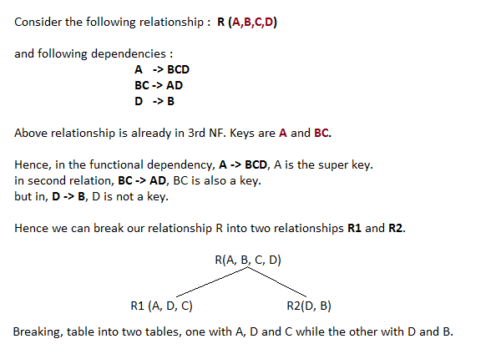
Normalization (Contd)
Boyce and Codd Normal Form (BCNF):
Boyce and Codd Normal Form is a higher version of the Third Normal form. This form deals with certain type of anamoly that is not handled by 3NF. A 3NF table which does not have multiple overlapping candidate keys is said to be in BCNF. For a table to be in BCNF, following conditions must be satisfied:
R must be in 3rd Normal Form
and, for each functional dependency ( X -> Y ), X should be a super Key.

Slide 25
Denormalization
Denormalization:
In computing, Denormalization is the process of attempting to optimize the read performance of a database by adding redundant data or by grouping data. In some cases, denormalization is a means of addressing performance or scalability in relational database software
Examples of denormalization techniques include:
Materialized views which may implement the following:
Storing the count of the "many" objects in a one-to-many relationship as an attribute of the "one" relation
Adding attributes to a relation from another relation with which it will be joined
Star schemas, which are also known as fact-dimension models and have been extended to snowflake schemas
Prebuilt summarization or OLAP cubes

Slide 26
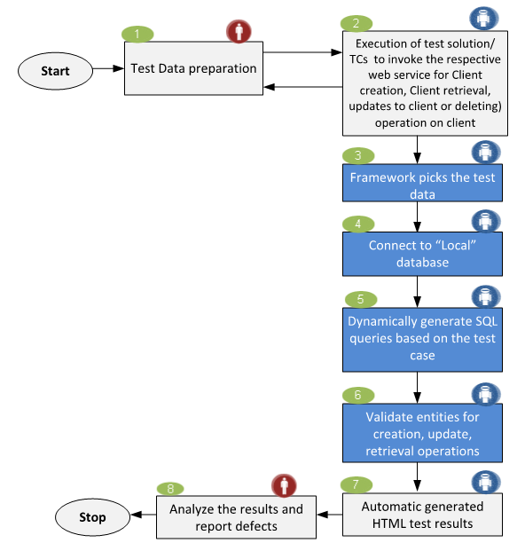
Geico Test Automation Framework

Slide 27
How to Interact with DB using Automation
Create Connection Object
Create Record set Object
Connect to DB using provider and server
Writing SQL Query
Execute Query

Slide 28
Database connection using ADODB
In ADODB, it looks as below:
Step 1: Create an ADODB connection object which is required step for connecting to DB as below:
Set ObjConnection = CreateObject (“ADODB.Connection”)
Step 2: Create Recordset which is for getting a value from database
Set objRecordSet = CreateObject(“ADODB.Recordset”)
Step 3: Authentication using Id, Password and details.
objConnection.open “provider=xxxx; Server = ServerName; User Id = username; Password =password; Database = DBname; Trusted_connection = Yes”
Step 4: Enter the required SQL query to be executed
SQLquery = “Select * from EMP where empid = 1001”
Step 5:
Execution of the query with the statement below: ObjRecordSet.open sqlQuery, ObjConnection.

Slide 29
Database connection using C#
You can connect your C# application to data in a SQL Server database using the .NET Framework Data Provider for SQL Server. The first step in a C# application is to create an instance of the Server object and to establish its connection to an instance of Microsoft SQL Server.
The SqlConnection Object is Handling the part of physical communication between the C# application and the SQL Server Database . An instance of the SqlConnection class in C# is supported the Data Provider for SQL Server Database. The SqlConnection instance takes Connection String as argument and pass the value to the Constructor statement.
Sql Server connection string
connetionString="Data Source=ServerName; Initial Catalog=DatabaseName;User ID=UserName;Password=Password"
If you have a named instance of SQL Server, you'll need to add that as well.
"Server=localhost\sqlexpress"
When the connection is established , SQL Commands will execute with the help of the Connection Object and retrieve or manipulate the data in the database. Once the Database activities is over , Connection should be closed and release the Data Source resources.
cnn.Close();

Slide 30
Database connection using C#.....contd
A Sample C# Program that connect SQL Server using connection string.
using System;
using G = System.Configuration;
using D = System.Data;
using C = System.Data.SqlClient;
using T = System.Text;
namespace ConnectAndQuery_Example
{
class Program
{
static void Main()
{
string connectionString4NoUserIDNoPassword,
password, userName, SQLConnectionString;
connectionString4NoUserIDNoPassword = Program.GetConnectionStringFromExeConfig
("ConnectionString4NoUserIDNoPassword");
Console.WriteLine("Enter your User ID, without the trailing @ and server name: ");
userName = Console.ReadLine();
password = Program.GatherPasswordFromConsole();
SQLConnectionString = "Password=" + password + ';' + "User ID=" + userName + ";“ + connectionString4NoUserIDNoPassword;
using (C.SqlConnection connection = new C.SqlConnection(SQLConnectionString))
{
C.SqlCommand command = new C.SqlCommand();
command.Connection = connection;
command.CommandType = D.CommandType.Text;
command.CommandText = @"SELECT TOP 9 CustomerID, NameStyle, Title, FirstName, LastName FROM SalesLT.Customer;";
connection.Open();
C.SqlDataReader reader = command.ExecuteReader();
while (reader.Read())
{
Console.WriteLine("Values: {0}, {1}, {2}, {3}, {4}", reader[0], reader[1], reader[2], reader[3],reader[4]);
}
}
Console.WriteLine("View the results here, then press any key to finish...");
Console.ReadKey(true);
}

Slide 31
No SQL
NoSQL database, also called Not Only SQL, is an approach to data management and database design that's useful for very large sets of distributed data.
NoSQL encompasses a wide range of technologies and architectures to solve the scalability and big data performance issues.
NoSQL is especially useful when an enterprise needs to access and analyze massive amounts of unstructured data or data that's stored remotely on multiple virtual servers in the cloud.
NoSQL does not prohibit structured query language (SQL).
NoSQL database might organize data into objects, key/value pairs.
Examples of NoSQL databases : Apache Cassandra, SimpleDB, Google BigTable, Apache Hadoop, MapReduce, MemcacheDB, and Voldemort.
Companies that use NoSQL include NetFlix, LinkedIn and Twitter, Google, Microsoft.

Slide 32
RDBMS vs NoSQL
Applications create massive volumes of new, rapidly changing data types — structured, semi-structured, unstructured and polymorphic data.
Short Development cycles/ Sprints of 1-2 weeks.
Applications that once served a finite audience are now delivered as services that must be always-on, accessible from many different devices and scaled globally to millions of users.
Organizations are now turning to scale-out architectures using open source software, commodity servers and cloud computing instead of large monolithic servers and storage infrastructure.
NOSQL can handle large volumes of rapidly changing structured, semi-structured, and unstructured data.
NOSQL supports Agile sprints, quick schema iteration, and frequent code pushes
NOSQL supports Object-oriented programming that is easy to use and flexible.
NOSQL supports geographically distributed scale-out architecture instead of expensive, monolithic architecture

Slide 33


Thank You
EXPERIENCE
EXPERTISE
R&D
APPROACH (KEEP-CUSTOMER-FOR-LIFE approach)

